Slide 1

Welcome to the
Auckland NZ – We are kicking it off

Slide 2
Housekeeping

Slide 3
Welcome to Global Azure Bootcamp 2017 from two good friends!
Hi from the Azure team video

Slide 4
Sponsors & Prizes

Slide 5



A BIG thank you to the 2017 Local Sponsors!

Slide 6





A BIG thank you to the 2017 Global Sponsors!
For providing the “Stuff We All Get”!

Slide 7



“Stuff We All Get”
Sponsor | Offering
Cloudmonix https://cloudmonix.com/ | Cloudmonix offers 1 full month of unlimited monitoring under the Ultimate plan.
SentryOne http://www.sentryone.com/ | SQL Sentry offers an extended evaluation for every attendee.
ServiceBus360 http://www.servicebus360.com/ | Servicebus360 offers an extended license until September 30 for all attendees, and this for 3 namespaces, 3 alarms per namespace, 3 resources per namespace to monitor and 2 users.
OpsGility http://www.Opsgility.com/ | Opsgility offers a 30 day subscription free trial for all attendees.

Slide 8

Raffle Prizes
1 Winner: One license chosen from ReSharper, dotTrace Memory, dotTrace Performance, dotCover, dotPeek, PhpStorm, PyCharm, IntelliJ IDEA, AppCode, WebStorm, RubyMine. You’ll receive a voucher with a code from the organizers.
1 Winner: a 1 year license of DBSentry (formerly Performance Advisor for Azure SQL Database) for raffle per location. Give your Full name and email to the Organizers.
MyGet is offering a free Starter subscription for 1 year for 1 attendee per location. Give your Full name and email to the Organizers.
They offer 3 12-month subscriptions per GAB Location.
Give your Full name, email phone and company to the Organizers.

Slide 9
Azure and Xamarin
Azure and Xamarin video

Slide 10
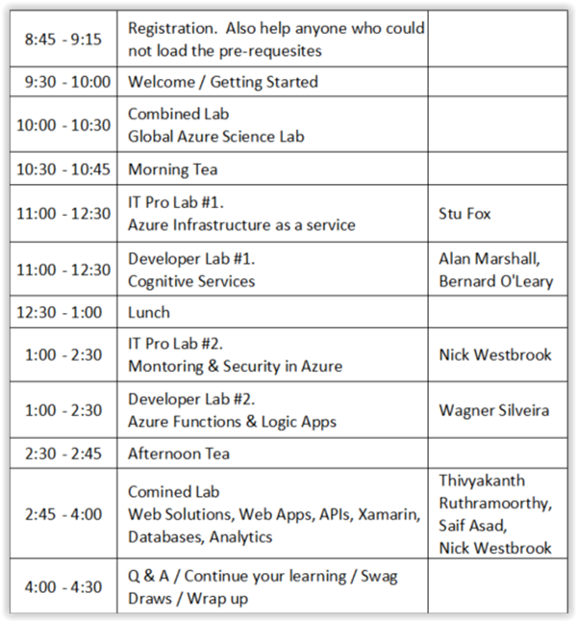
Schedule

Slide 11
The links!
Bootcamp information
Bootcamp details
Github repository

Slide 12
Global Azure Bootcamp 2017 Science Lab

Slide 13
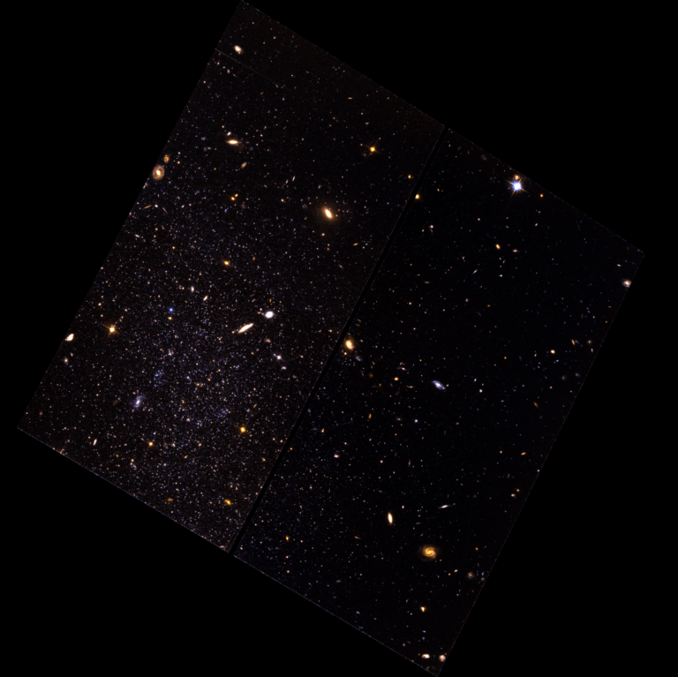
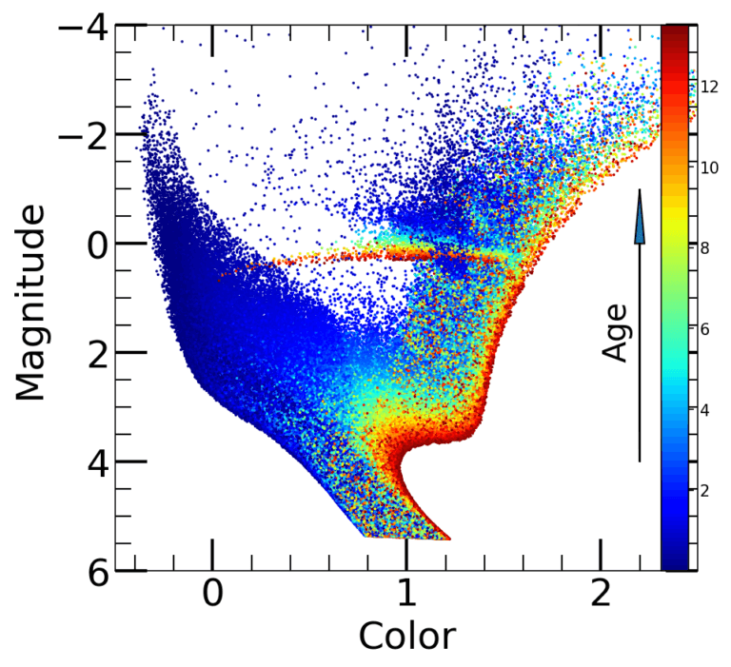

In previous years we have tried to bring you a science lab that is both interesting and represents great research. This year is no exception, this year we bring you the stars themselves!
The Science Lab takes a look at Star Formation History (SFH) to see how many stars of a specific metallicity are formed in a galaxy during its lifetime. Traditional approaches are affected by uncertainties associated with observations or the limited accuracy of models when running computer code, making it difficult to accurate calculate the age of stars within a galaxy.
To overcome this, we need to correct for these effects to obtain the “true” SFH. The objective of the Seliga (SEcret LIfe of GAlaxies) algorithm, developed by Sebastian L. Hidalgo from the Instituto de Astrofísica de Canarias (IAC), is to limit the impact of all these effects so we can compare the predictions of the models more directly with the observations. This task needs a huge number of tests that can be performed successfully only by using distributed computing, like the one you will deploy in the Global Azure Bootcamp Science Lab.
By taking part in the Science Lab, you will be helping to contribute to the body of knowledge in this important field that allows researchers to understand the very beginnings of the universe itself. We hope you choose to deploy the packages that will run the Seliga algorithm, and deliver real results to the researchers.
The Secret Life of Galaxies

Slide 14
Science Lab Architecture
To show the power of Azure in the Global Azure Bootcamp Science Lab this year we have created a solution that maximises the use of Azure resources whilst providing the research team with large volumes of computing power.
The Seliga algorithm runs in an Azure Batch process that YOU deploy and scale as you want.
For extra fun, there is a dashboard showing global scores so you can compete against your friends or other people around the world.

Slide 15
Global Azure Bootcamp 2017 Science Lab
About http://bit.ly/gablab2017about
Instructions http://bit.ly/gablab2017run
Lab Key: <ENTER YOUR LOCATION LAB KEY HERE XXX-XXX-XXX>
Dashboard http://gablab2017.azurewebsites.net

Slide 16
Time to get going! Have a GREAT Azure day!

